Slide 1
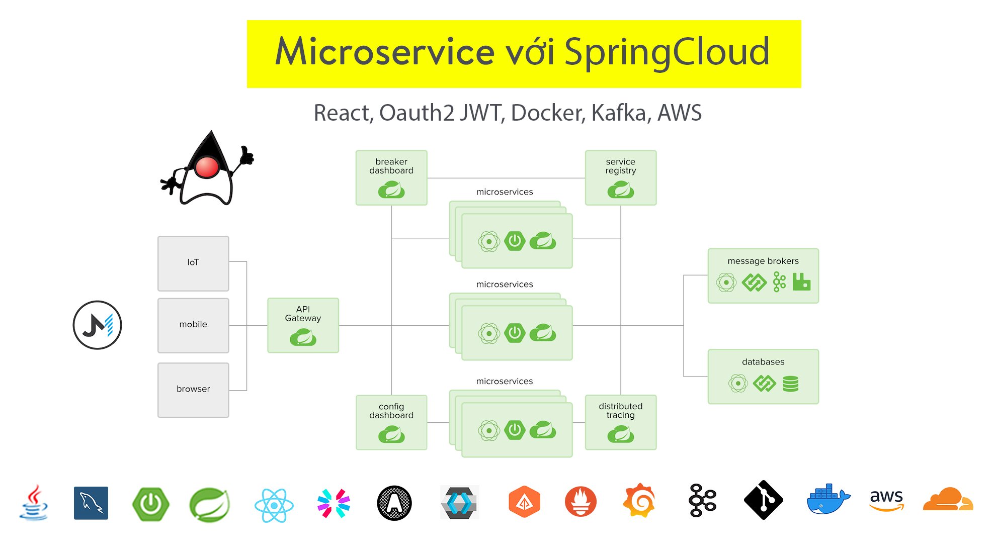

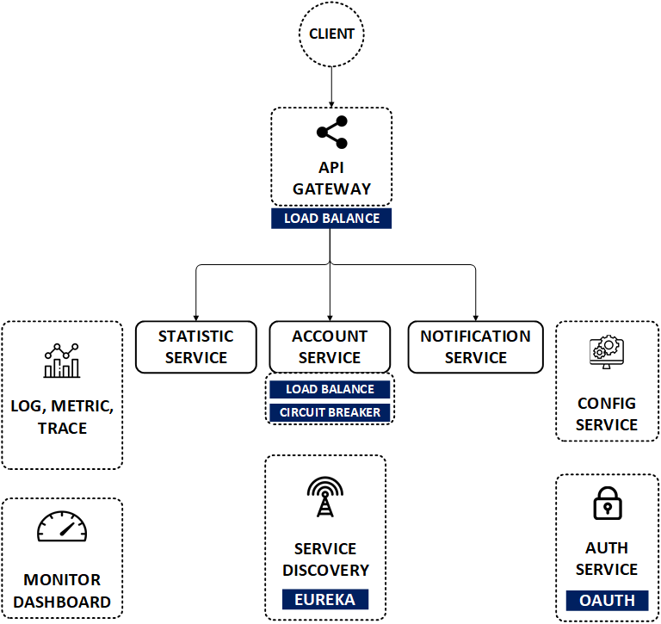

Microservices OAuth2 Security & React Js

Slide 2

Hello!
I am JMaster.io
Find me at www.jmaster.io
Khóa học:
Microservices with Spring Cloud & OAuth 2 Security

Slide 3
1.
Microservices
Kiến trúc microservice là "chuẩn mực mới", mang lại sự linh hoạt tuyệt vời và nhiều lợi ích bổ sung.

Slide 4
Microservices are a modern approach
Application code is delivered in small, manageable pieces, independent of others
Small scale and relative isolation can lead to many additional benefits, such as easier maintenance, improved productivity, greater fault tolerance, better business alignment, etc.

Slide 5
Making code ‘cloud-native’ means dealing with 12-factor issues
Codebase
Dependencies
Config
Backing services
Build, release, run
Processes
Port binding
Concurrency
Disposability
Dev/prod parity
Logs
Admin processes
www.12factor.net

Slide 6
Spring Cloud is great tools to build microservices
Spring Boot, microservices can start small config and grow business fast
Spring Cloud with ready-to-run cloud patterns, can help with service discovery, load-balancing, circuit-breaking, distributed tracing, and monitoring, API gateway

Slide 7
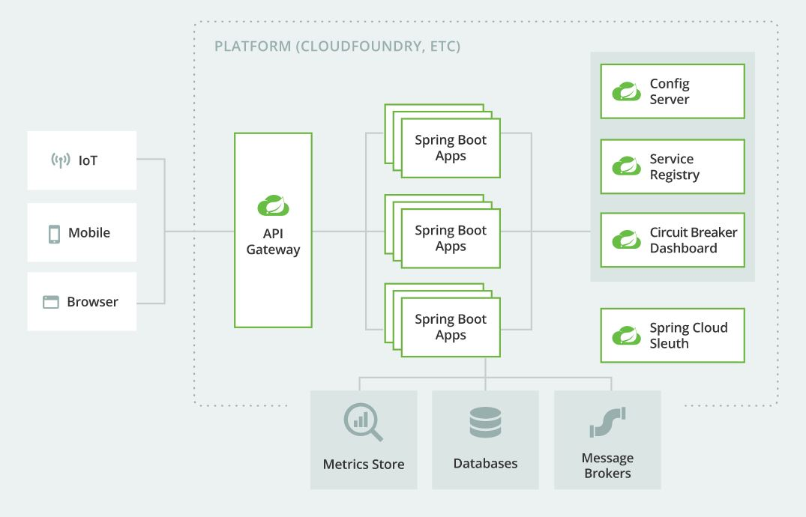

Slide 8
2. Java Roadmap
Spring Cloud
Java Servlet
2
4
1
3
Java Core
Spring Boot
5
DevOps

Slide 9
3. Pre Skills
Spring Cloud
We learn this course
Spring Boot
MVC, JPA, Security, REST
Java Servlet
Servlet, Filter, Session, HTML/CSS
Java Core
Java OOP, JDBC, SQL

Slide 10

4. Course Resources
Membership Course
& Some resources are Free

Slide 11
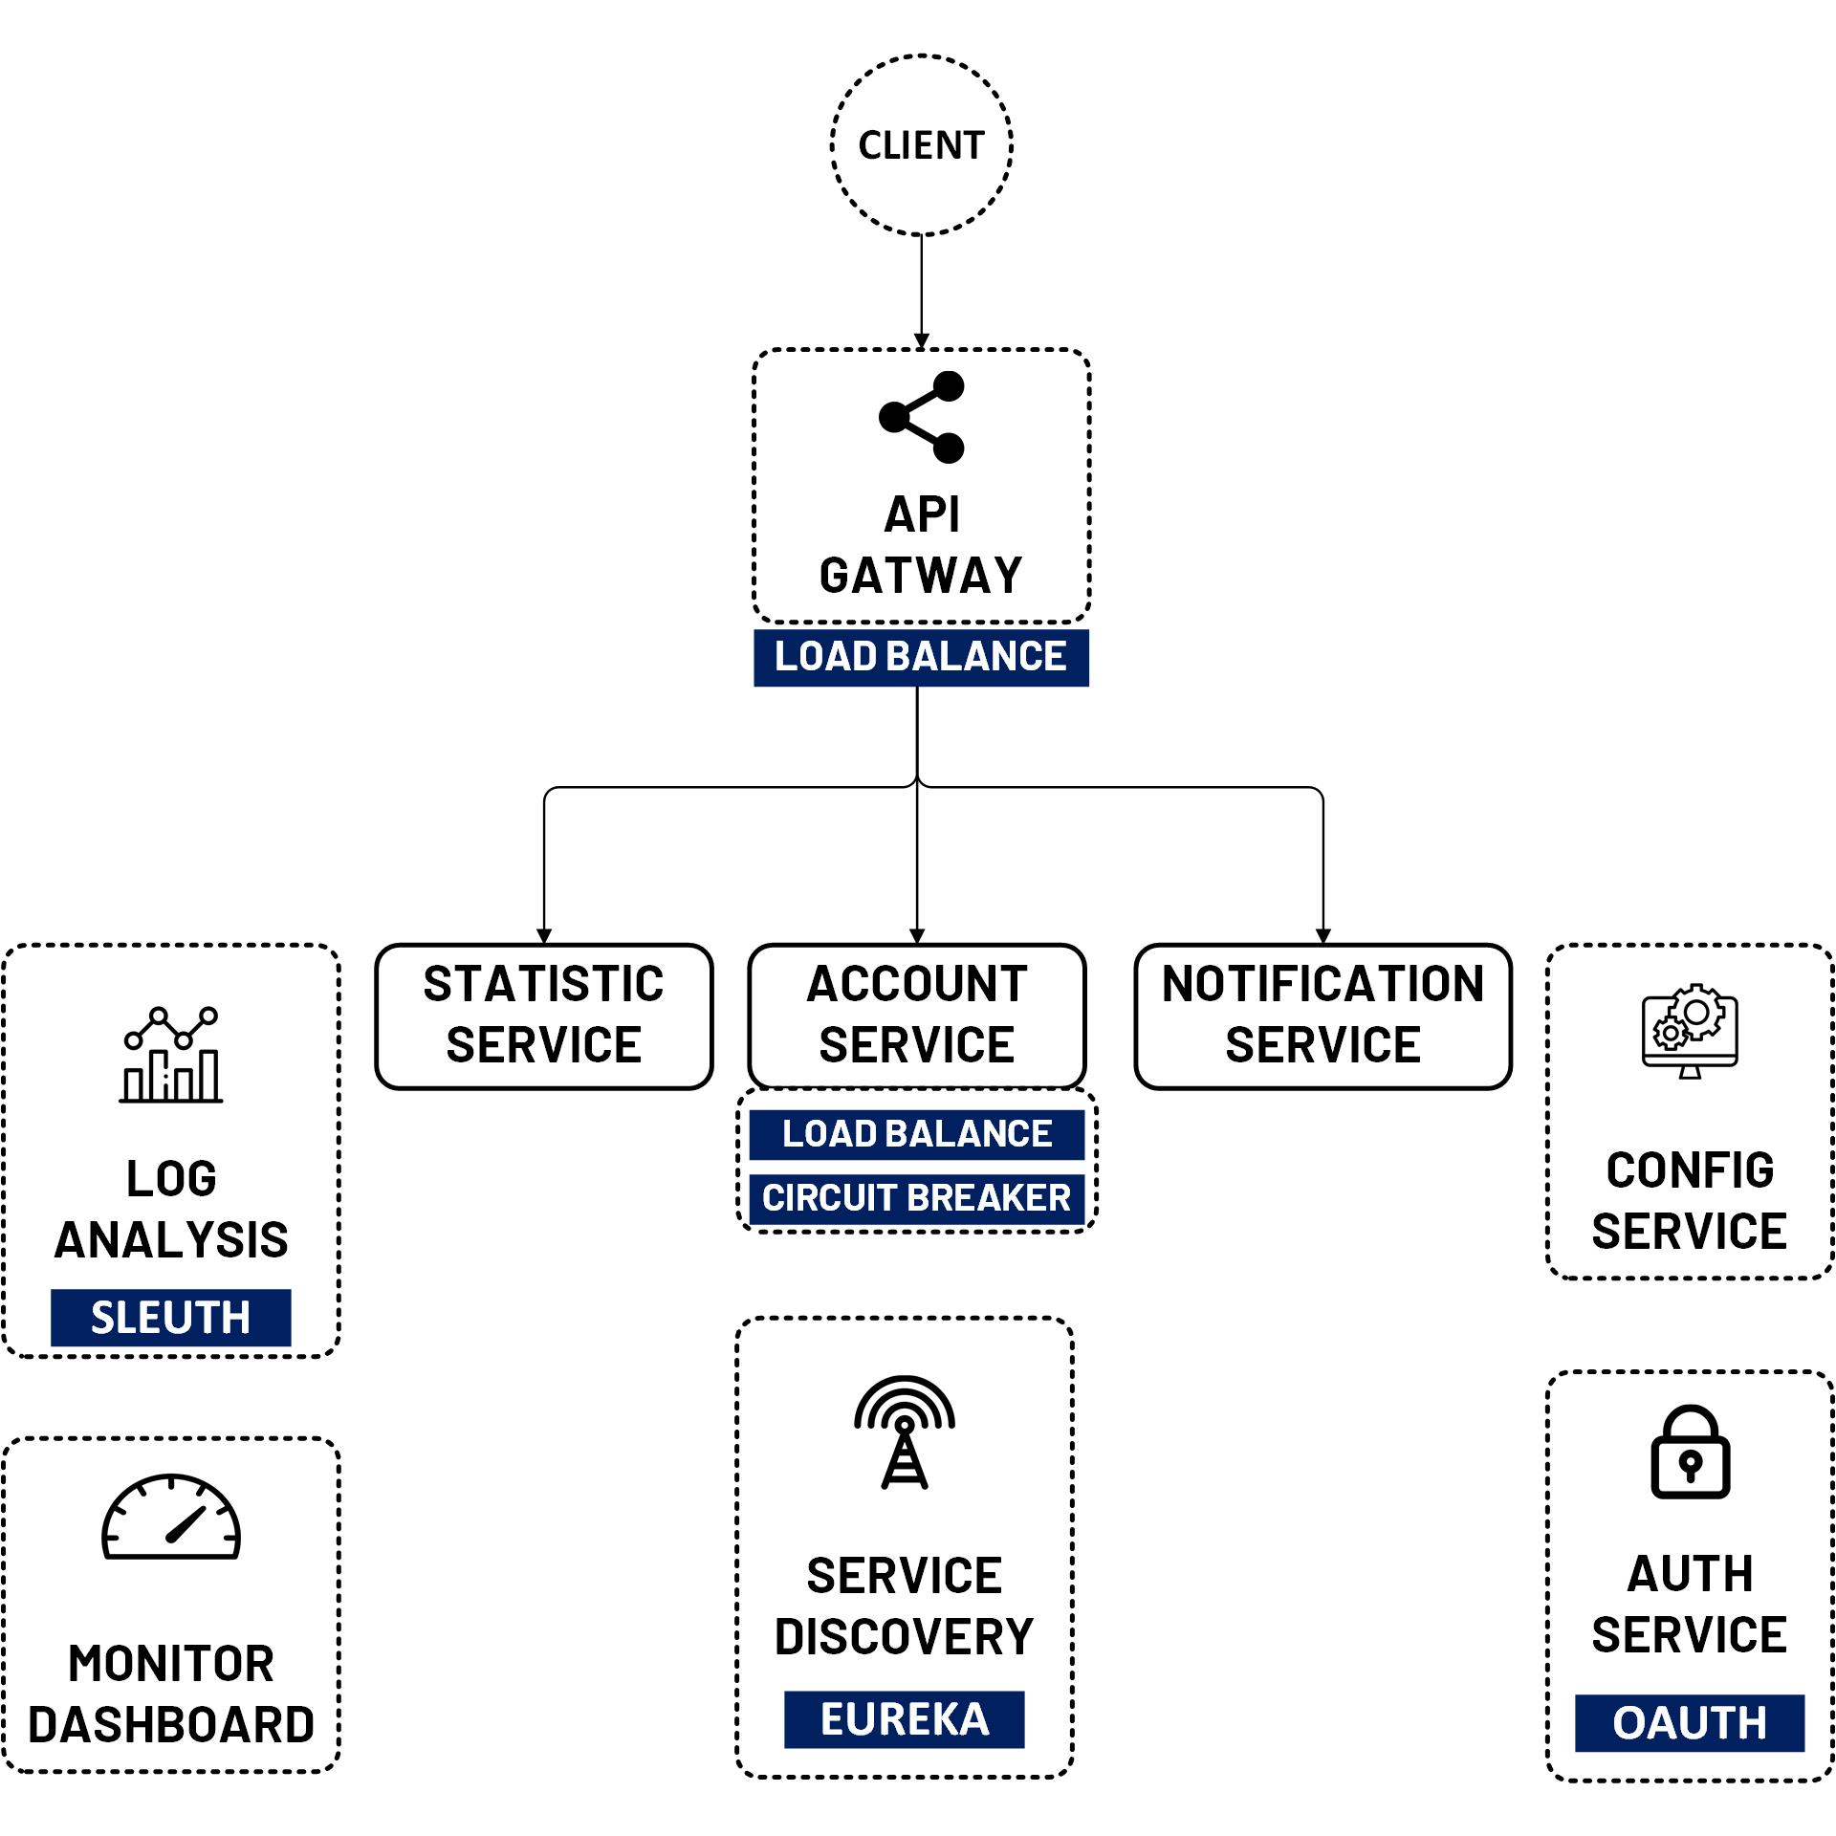
Easy Learn
Microservice with Spring Boot
Service Discovery
Config Service
Service API Gateway
OAuth2 Security Service
Load Balance, Circuit Breaker
Log Analysis
Monitor Dashboard
Frontend UI – JQuery / React Demo
More lessons updating….

Slide 12

5. Membership
Videos & Documents
Github Code Sample
Instant Chat Support
Full HD Videos, documents, blogs
Sample code of Video. Project Code
Chat, Teamview, Quick Fix, Discuss more on learning.
1
2
3

Slide 13

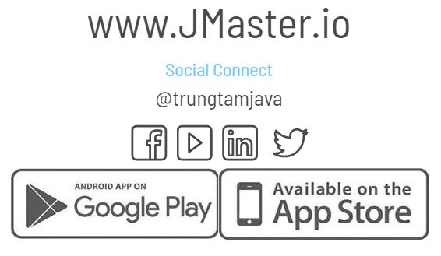
Thanks!
Any questions?

